Slide 1
Latin Root Words II
Created by Grace Seymour, 2011

Slide 2
To send
Dismiss
Admission
Dissmissal

Slide 3
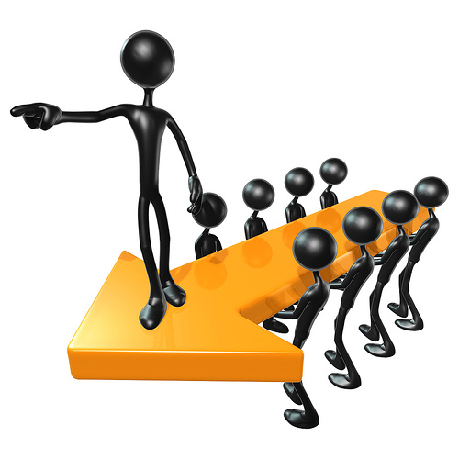
To Lead
Conduct
Educate
Produce
Introduction

Slide 4
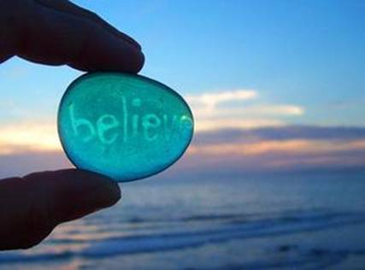
To Believe
Credit
Incredible
Accredit

Slide 5
To Turn
Advertise
Invert
Convert
Vertical

Slide 6
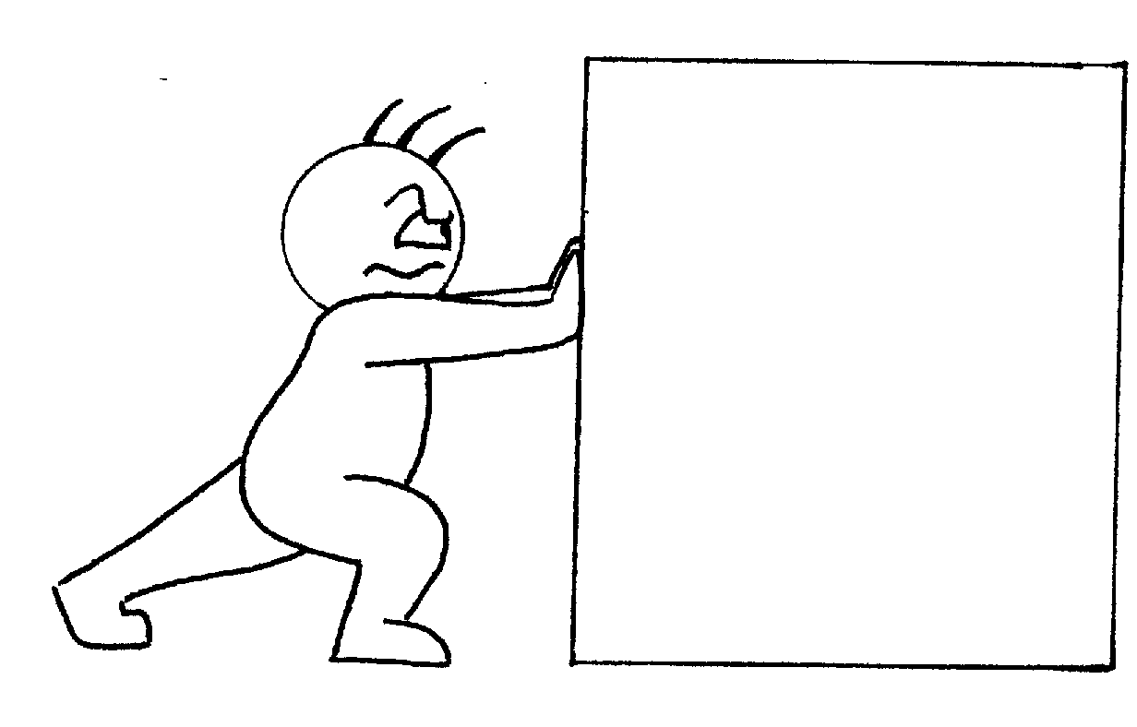
To Drive Or Push
Expel
Propeller
Repellent

Slide 7
To Make Or Do
Factory
Fact
Facility

Slide 8
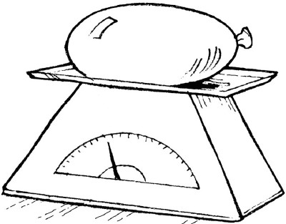
To Hang Or Weigh
Dispense
Expense
Expensive
Suspense

Slide 9
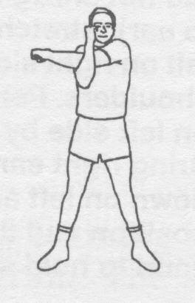
To Stretch Or Strain
Extend
Tendency
Pretend

Slide 10
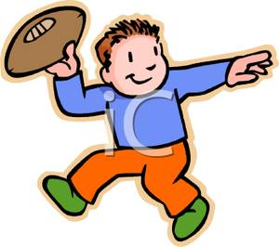
To throw Or lie
Project
Reject
Eject

Slide 11
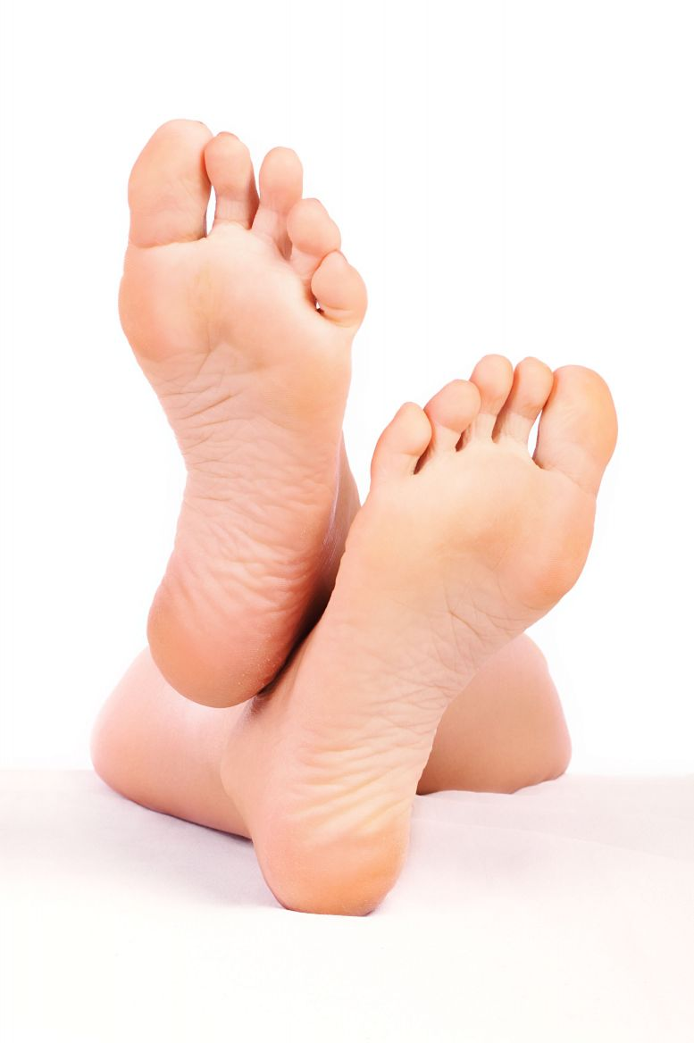
Foot
Peddle
Pedometer
Pedicure

Slide 12
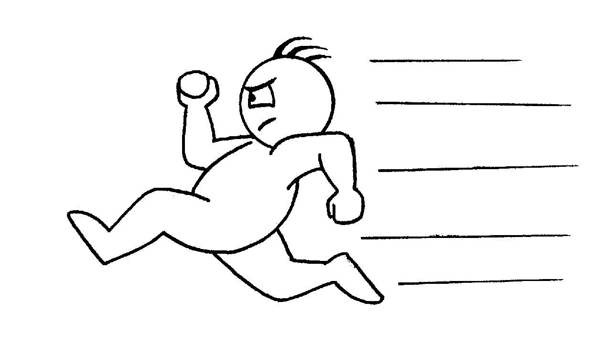
To Run Or Go
Current
Curricular
Cursive
Cursor

