Slide 1
Latin Roots III
Created by Grace Seymour, 2011

Slide 2
To hear or listen
Audio
Audition
auditorium

Slide 3
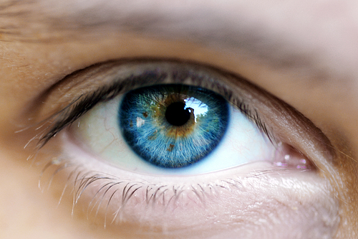
To see
Visual
Visor
visit

Slide 4
Law
Legislative
Legislation
Legislate

Slide 5
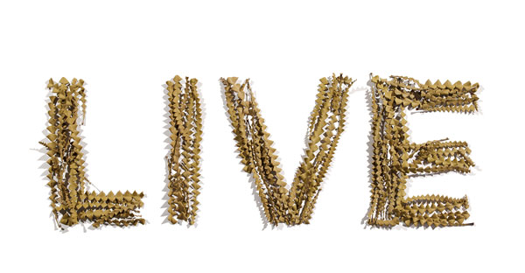
To live
Survival
Revive
Vitamin

Slide 6
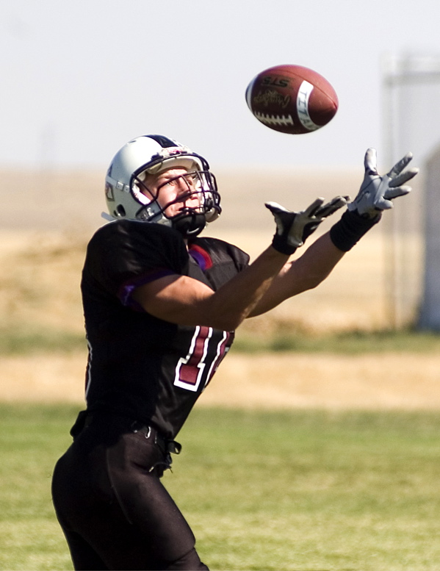
To take, catch, hold, receive.
Recap
Receipt
receive

Slide 7
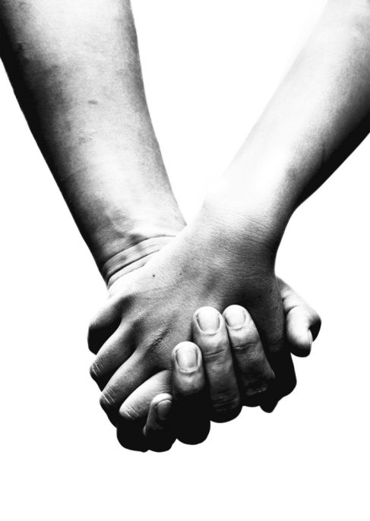
To hold
Contain
Container
Contents

Slide 8
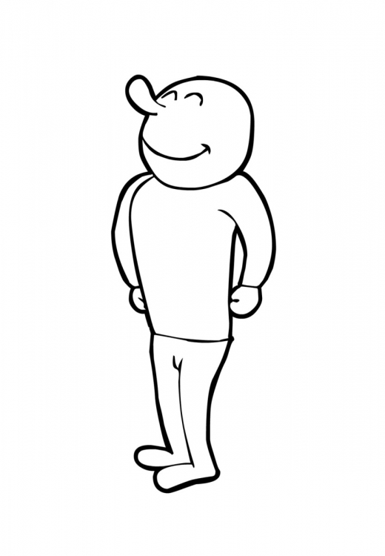
To Stand
Assistant
Status
Constant

Slide 9
To Put, Place, or Set.
Compose
Pose
Opposite

Slide 10
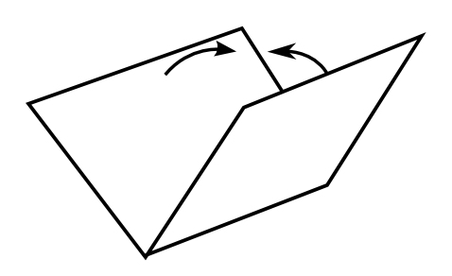
To Fold
Accomplice
Complication
Duplicate

