Slide 1
Microsoft PowerPoint 2007
Quick Reference Guide for Teachers

Slide 2
Add fill Color to Box on slide

Slide 3
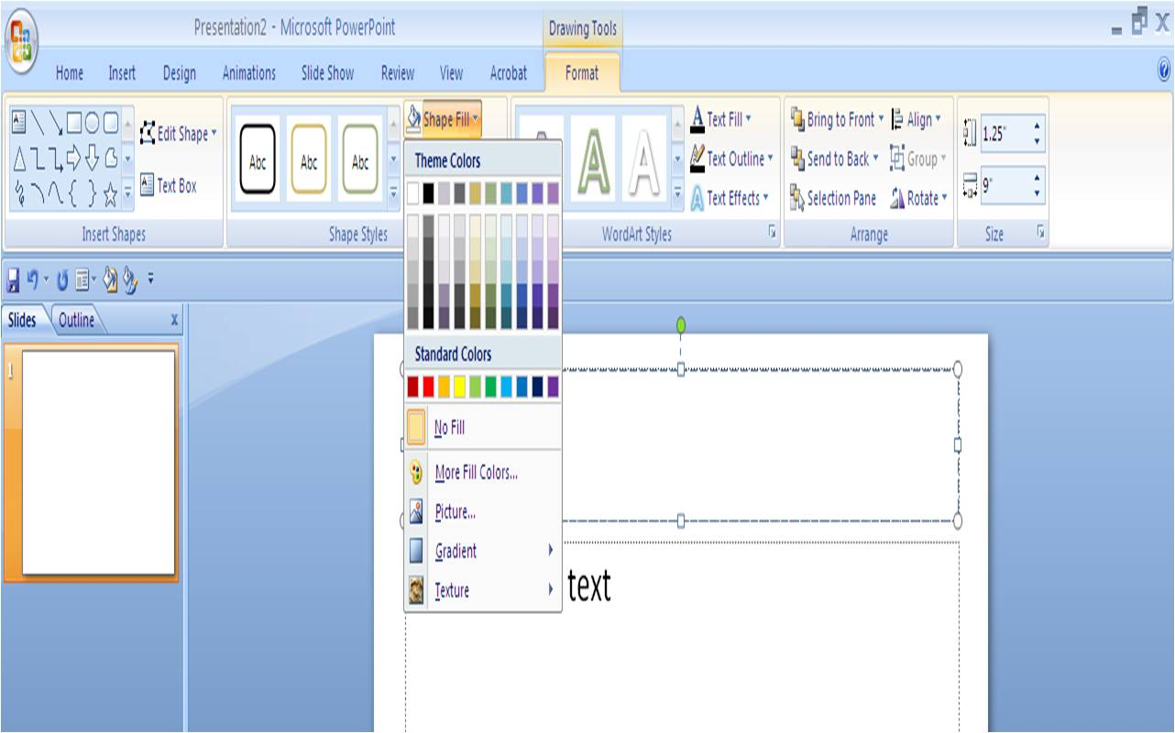
Click Format,
Shape Fill and choose color for box

Slide 4
Select type of Font(Text ) you want

Slide 5
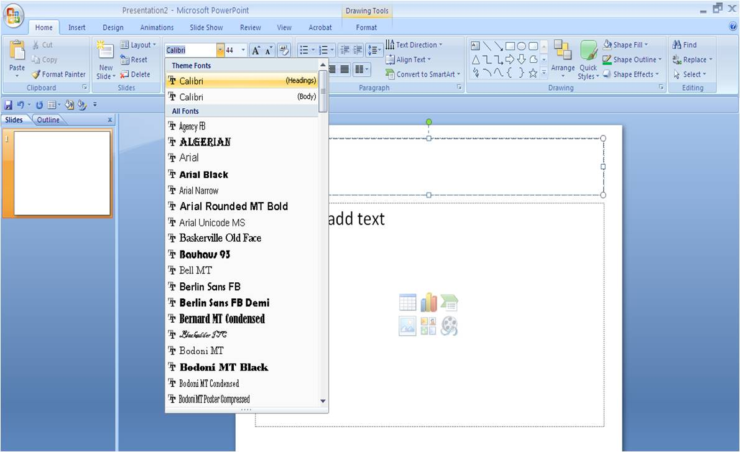
Click Home
Click drop down box
Choose which type of font you want

Slide 6
Add Color to your Font(Text)

Slide 7
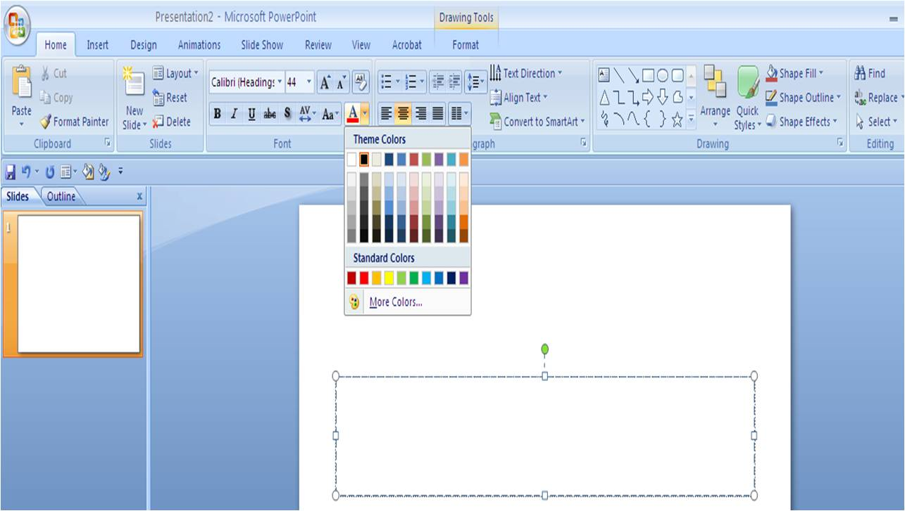
Click Home
Click “A” with the rectangle underneath it
Choose color

Slide 8
Insert Clip Art on your slide

Slide 9
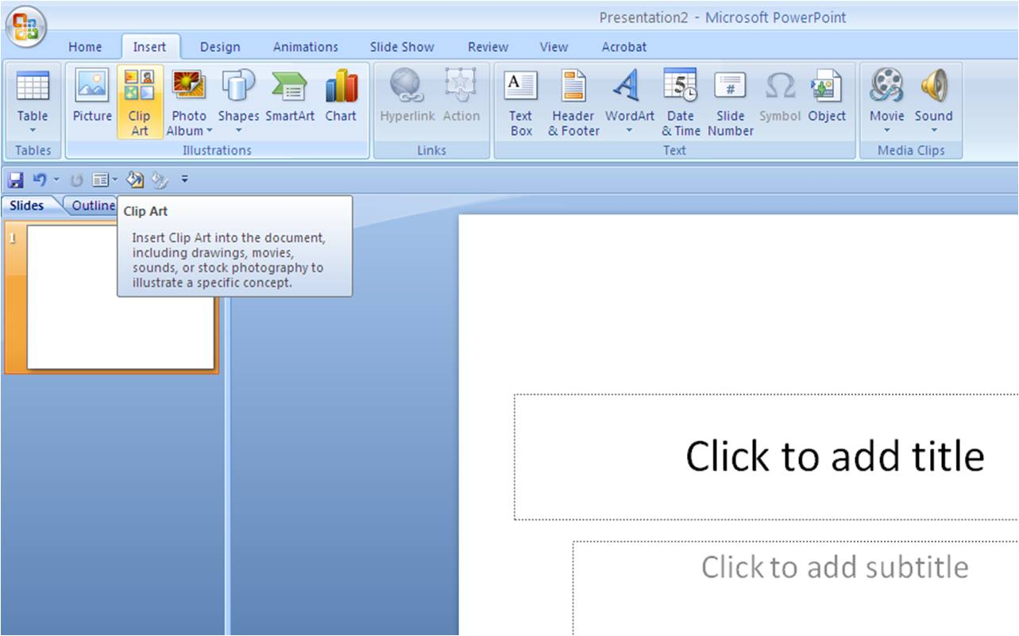
Click Insert
Clip Art
Then type in what picture you are looking for and hit search

Slide 10
Add a Picture to your slide

Slide 11
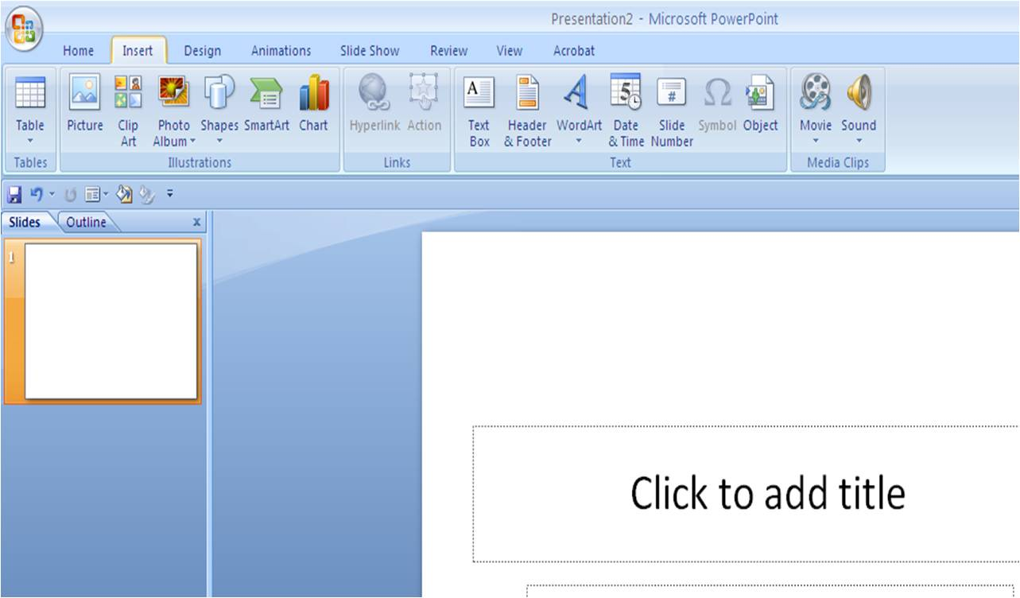
Click Insert
Click Picture
Select which file your picture is in

Slide 12
Insert a Text Box on your slide

Slide 13
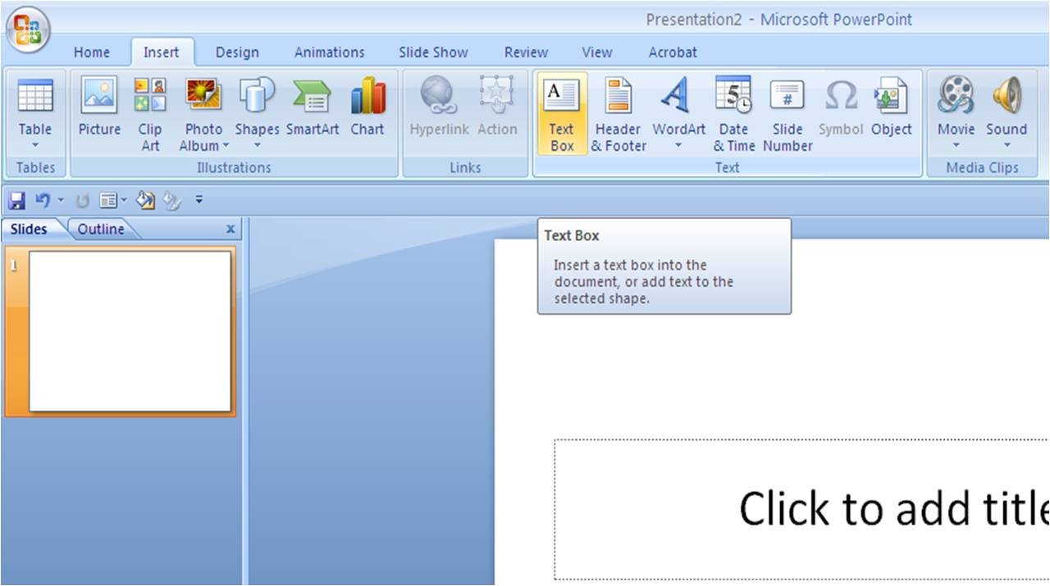
Click Insert
Click Textbox
Drag mouse to place on slide

Slide 14
Insert a Shape to Your Slide

Slide 15
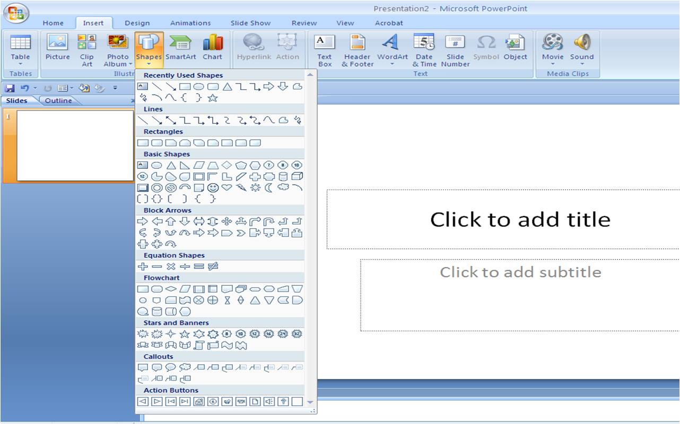
Click Insert
Click shapes
Choose the shape you want

Slide 16
Add A New Slide

Slide 17
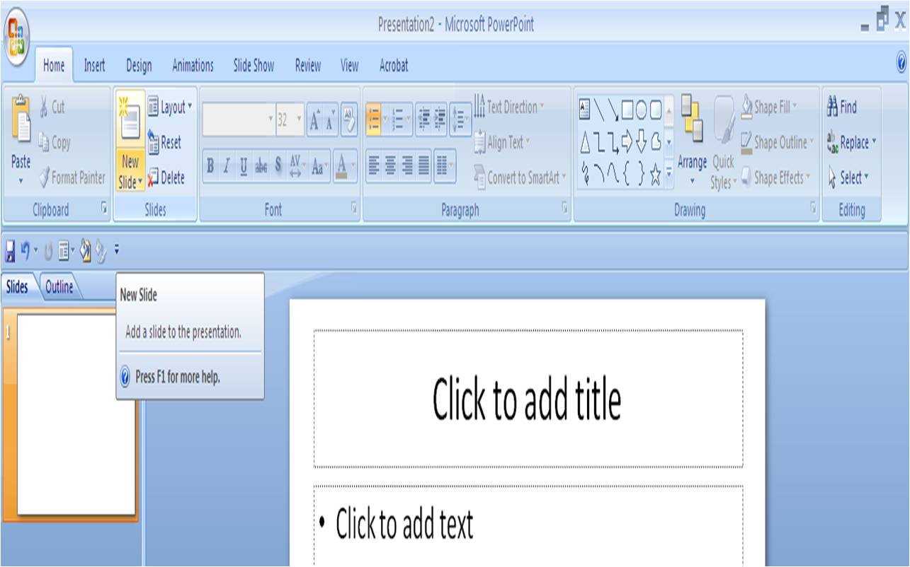
Click Home
Click New Slide

Slide 18
Add Color to a Shape

Slide 19
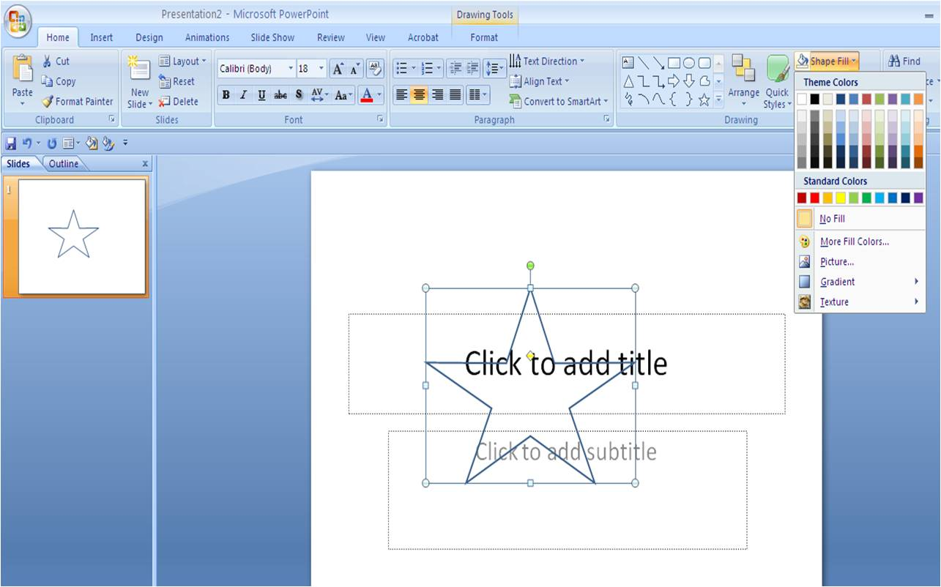
Click Home
Click Shape Fills

Slide 20
Use A Solid Color for your Background

Slide 21
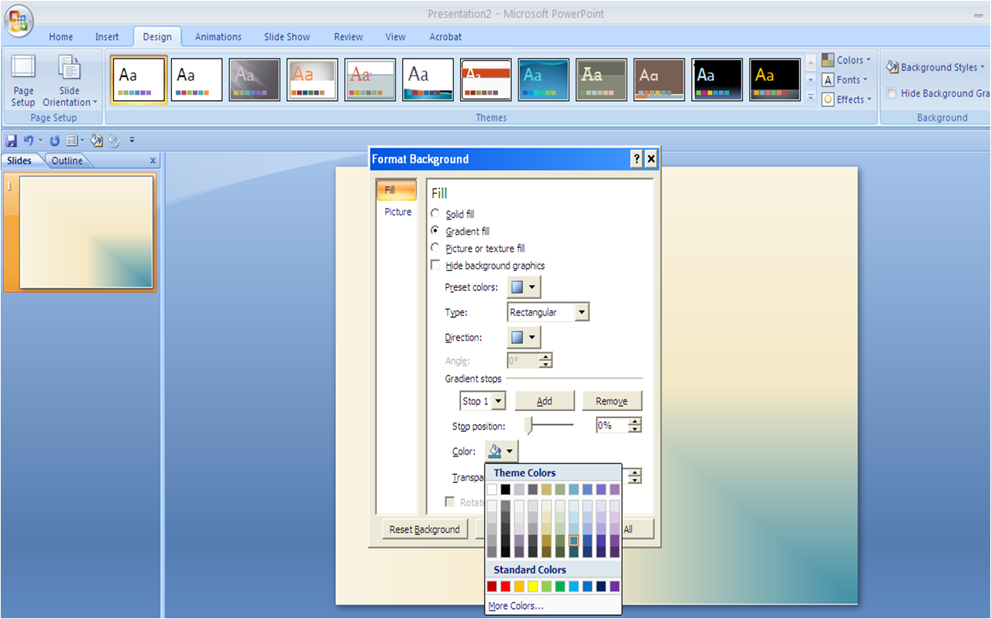
Click Design
Click Background Styles
Click Format Background

Slide 22
Use a Texture for Your Slide Background

Slide 23
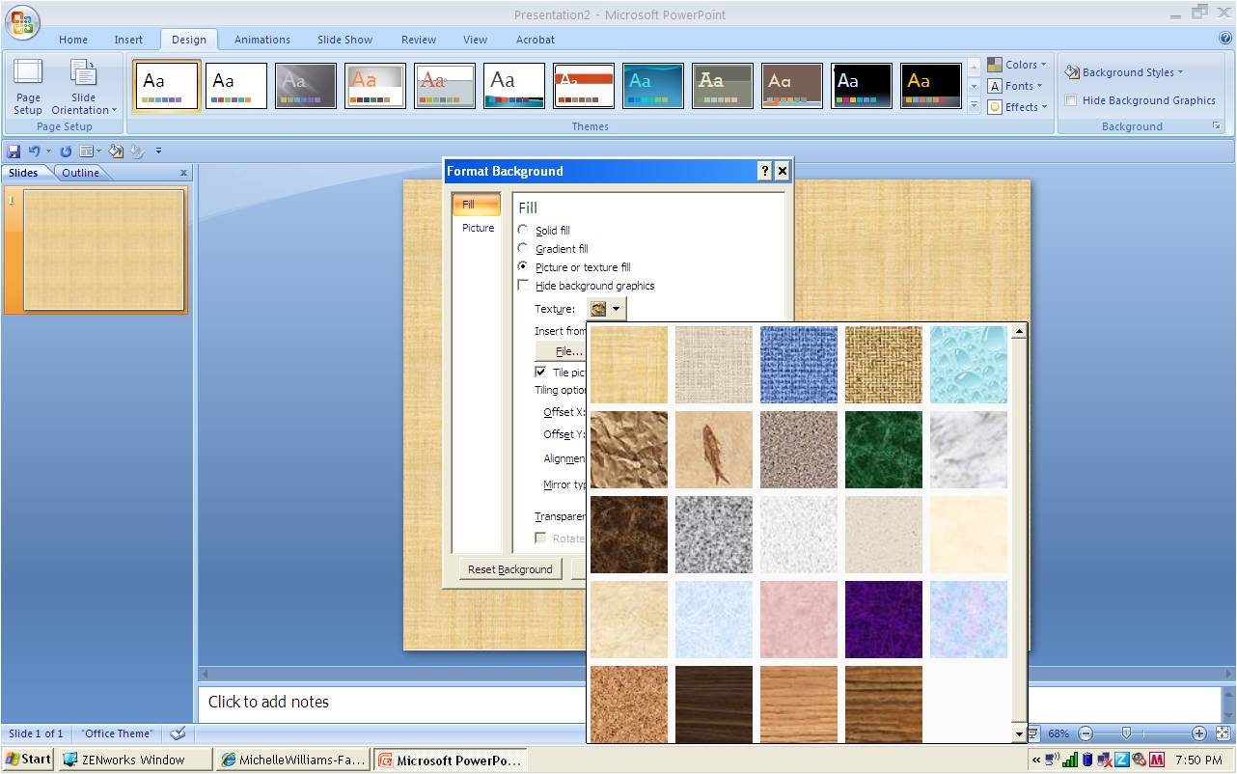
Click Design
Click Background styles
Click Format Background
Choose Texture fill

Slide 24
Add A Slide Transition

Slide 25
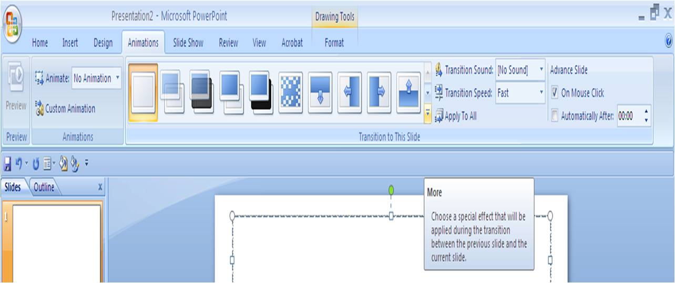
Click Animations
Click drop down arrow next to transitions

Slide 26
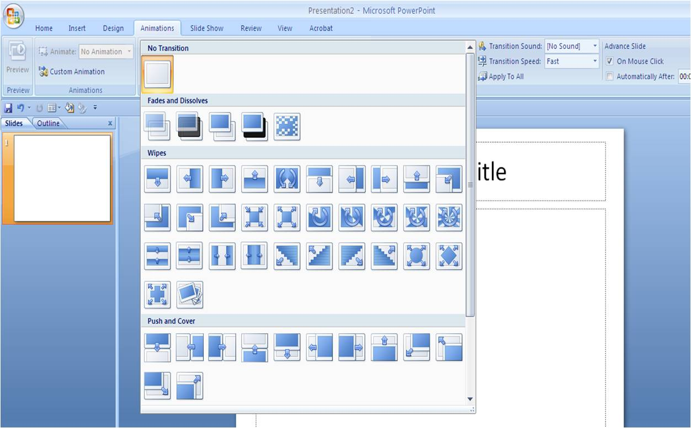
Click Animations
Click transition drop down arrow
Choose the transition you want

Slide 27
View Your Slideshow

Slide 28
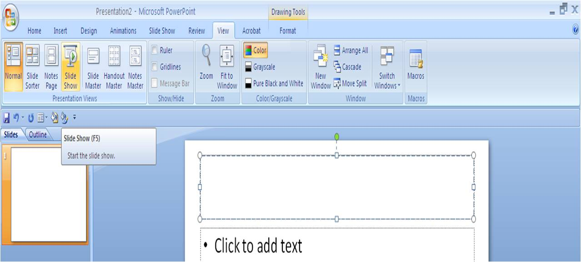
Click View
Click Slideshow

Slide 29
ADD WORD ART

Slide 30
Click Insert
Click Word Art
Choose the type you want to use

Slide 31
Adding Animation
To Your Slides

Slide 32
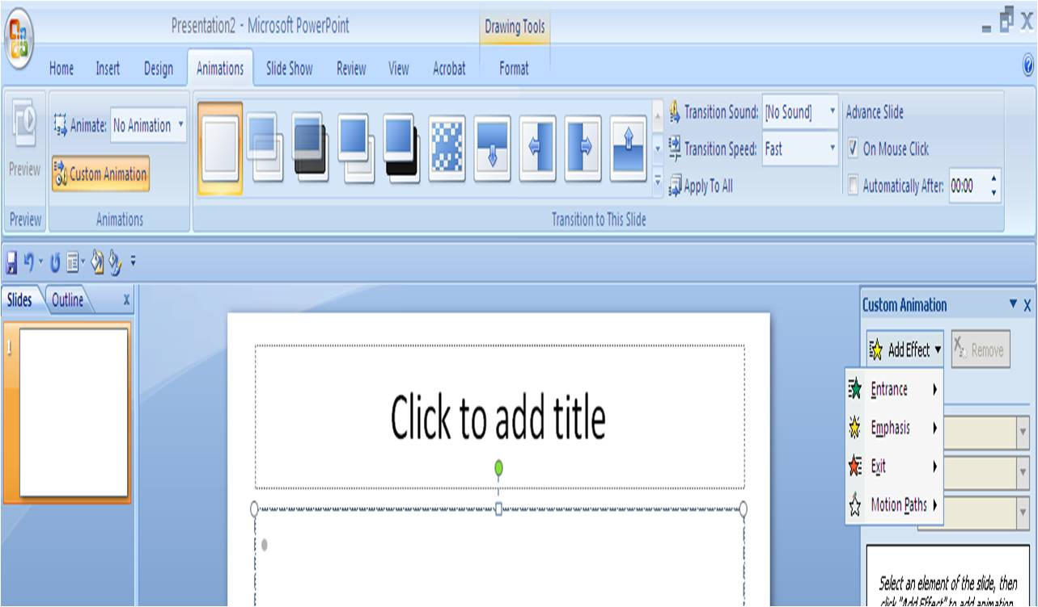
Click Animations
Click Custom Animation
Click Add Effect
Choose From the drop down Menu

